Slide 1


Effectively diagnose and debug .NET in Visual Studio
Mark Downie – Program Manager, Microsoft
@poppastring

Slide 2

Today’s topics
Debugging .NET with Windows Subsystem for Linux (WSL2)
Debugging Tips and Tricks
Getting started with the Performance Tool
Notes:
Today we are covering
VS to debugging with Linux
Tips and Tricks, how to use VS more effectively and efficiently
Perf tool, find inefficiency in code

Slide 3
What is the WSL 2?
The Windows Subsystem for Linux (WSL) lets developers run a GNU/Linux environment directly on Windows, unmodified, without the overhead of a traditional virtual machine or dualboot setup.
Select your favorite Linux distro from the Microsoft Store
Run common command-line tools (grep, awk, sed)
Run Bash shell scripts and command-line applications
WSL 2 is the latest version of the Windows Subsystem for Linux architecture.

Slide 4
Why debug with WSL2?
For a Windows .NET user targeting Linux, WSL 2 lives in a sweet spot between production realism and productivity.
Productivity
Speed
Easy install
In Visual Studio you can already debug in a remote Linux environment using the Remote Debugger, or with containers using the Container Tools.
Production realism

Slide 5
Demo time!
Problem: Open-source project DasBlog Core
Running fine locally and on Azure App Services of Windows
Problems running on Azure App Services for Linux (can I replicate the problem?)
The links for uploaded images are incorrect
Solution: Use Visual Studio native support for WSL 2 to investigate
New Launch Profiles
Track down some bugs in a Linux environment

Slide 6

Debugger Tips and Tricks
Pinnable properties
Step into a specific method
Run to Cursor (in the call stack)
Parallel Stacks
Improvements
Finding blocking code
Call Stack indicators

Slide 7
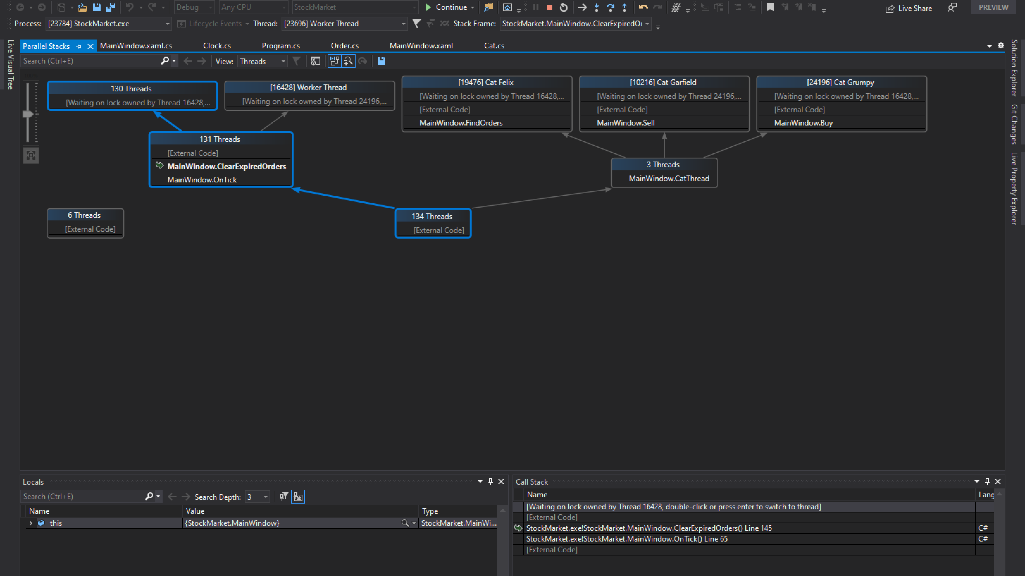

Slide 8

Getting started with Performance
CPU usage
.NET Async

Slide 9

Visual Studio 2019 16.8 GA and 16.9 Preview
Dev environments in the cloud
.NET productivity
GitHub Codespaces available as a limited “preview” for ASP.NET Core, .NET Core and C++
Roslyn analyzers are now included in the .NET 5.0 SDK
.NET Code Style analyzers can now be enforced on build ^{Preview}
AI-assisted productivity
Linux diagnostics
Team Completions: Get C# contextual suggestions for your own types, through custom models shared with your team
.NET Core Debugging with WSL 2 using the Linux distro of your choice ^{Preview}
Debug managed Linux core dump
Automated CI/CD workflow ^{Preview}
XAML productivity
GitHub Actions workflow from within Visual Studio for your .NET Core apps
XAML Binding Failures diagnostic improvements
Git workflows
Easily execute your daily Git operations using the Git Changes window
Browse and manage your Git repository and stop worrying about merge conflicts
visualstudio.com/download aka.ms/vs-preview

Slide 10

Thanks for joining!
Mark Downie (@poppastring)
visualstudio.com/download aka.ms/vs-preview

